Slide 1
Cover slide
Style 4
(choose one, delete the rest)
New
Scottish Capital Investment Manual
Final Release
Paul Mortimer
Asset Management Policy Advisor

Slide 2
Slide style containing only text
Final Release
Letter dated 29 March 2017
Directors of Finance
Directors of Facilities
Directors of Planning
Final versions of all documents now on website
http://www.pcpd.scot.nhs.uk/capital/scimpilot.htm
N.B.
Body Copy always uses Dark Blue NHS colour.

Slide 3
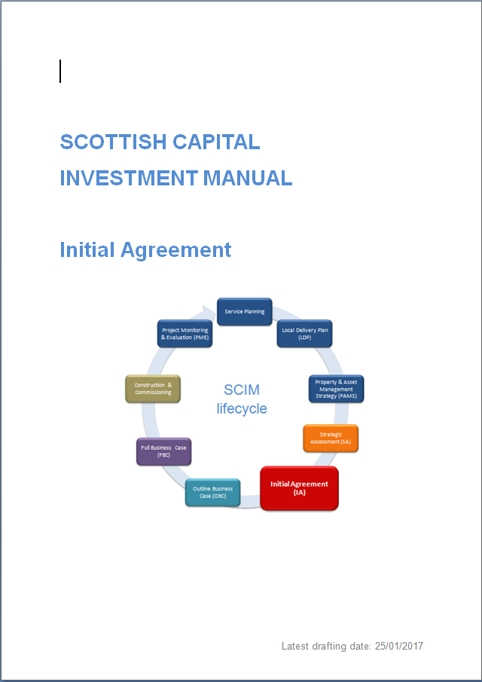
Image Only Slide
The New SCIM
Shadow effect to be used: “Drop Shadow Rectangle”
N.B.
Always leave enough white space (margin) around the image, so it can breathe.
N.B.
When scaling images/objects, please hold Shift key while scaling, to keep proportional shapes)

Slide 4
Image Only Slide
SCIM Investment Cycle
Service Planning
Outline Business Case (OBC)
Full Business Case (FBC)
Project Monitoring & Evaluation (PME)
Initial Agreement (IA)
Local Delivery Plan (LDP)
Property & Asset Management Strategy (PAMS)
Strategic Assessment (SA)
Construction
Shadow effect to be used: “Drop Shadow Rectangle”
N.B.
Always leave enough white space (margin) around the image, so it can breathe.
N.B.
When scaling images/objects, please hold Shift key while scaling, to keep proportional shapes)

Slide 5
Slide style containing only text
Purpose of key documents:
Strategic Assessment:
To outline need, benefits & priority of a proposal
Initial Agreement
To identify best service (or strategic) solution
Outline Business Case
To identify best investment option for implementation
Full Business Case
To recommend best commercial offer
Project Monitoring
To monitor progress, confirm success & share lessons
Service Benefits Evaluation
To demonstrate benefits to service
N.B.
Body Copy always uses Dark Blue NHS colour.

Slide 6
Slide style containing only text
List of Documents & Updates:
SCIM Introduction & Overview:
Introduction - minor updates
Summary of Stages
Initial Agreement – new
Outline Business Case – new
Full Business Case - new
Supporting Diagrams
SCIM Planning Overview – new
SCIM Process & Outcomes – now available
Information & Design Requirements - new
N.B.
Body Copy always uses Dark Blue NHS colour.

Slide 7
Slide style containing only text
List of Documents & Updates:
Strategic Assessment:
SA guide – guide to prioritisation scoring added
SA template_ppt – minor update
SA template_pdf - new
Outline Business Case
OBC guide – several but minor updates
Option Appraisal guide – minor update
GEM model – now available
GEM basic – new
Financial Case forms – now available
N.B.
Body Copy always uses Dark Blue NHS colour.

Slide 8
Slide style containing only text
List of Documents & Updates:
Full Business Case:
FBC guide – minor updates
Supporting Guidance:
Benefits Realisation – minor updates (community benefits)
Risk Management – no change
Project Monitoring & Benefits Evaluation – minor update
Commissioning Process – now available
NDAP guide – now available
NDAP form – now available
AEDET guide – now available
AEDET spreadsheet – now available
N.B.
Body Copy always uses Dark Blue NHS colour.

Slide 9
Chapter Page
Style 3
(choose one, delete the rest)
Any Questions?

Slide 10
Chapter Page
Style 3
(choose one, delete the rest)
Assessing Options with SCIM – a new supplementary guide

Slide 11
Slide style containing only text
Background:
Step change was needed in assessing options
Service model often left unchallenged
Initial Agreement became a mini-OBC
Design & site investigation started too early
Right building, but for right service?
N.B.
Body Copy always uses Dark Blue NHS colour.

Slide 12
Slide style containing only text
Assessing Options at different stages:
SA – no option assessment at this stage
IA – to identify preferred service / strategic solution
OBC – to identify best investment option for implementing service solution
FBC – to confirm best commercial offer
N.B.
Body Copy always uses Dark Blue NHS colour.

Slide 13
Slide style containing only text
Alternative solutions at IA stage:
Size, type & arrangement of local / regional services
Population based planning between hospitals, regions, and national provision
Not just those within the existing building
N.B.
Body Copy always uses Dark Blue NHS colour.

Slide 14
Slide style containing only text
Assessment at IA stage:
Review advantages & opportunities
Review disadvantages & constraints
Then, does it meet investment objectives?
Are the indicative costs affordable?
Building solution considered for costing purposes only
N.B.
Body Copy always uses Dark Blue NHS colour.

Slide 15
Slide style containing only text
Alternative Options at OBC stage:
Do Nothing / Do Minimum benchmark
Existing estate, new build, phasing, locations, different design solutions, etc
Site locations can be considered separately or together
N.B.
Body Copy always uses Dark Blue NHS colour.

Slide 16
Slide style containing only text
Assessment at OBC stage:
Non-financial benefits (linked to investment objectives & benefits register)
NPV / NPC whole life costs
Risk assessment (linked to risk register)
Sensitivity testing of results
Stakeholders make final decision
Design progresses throughout process
N.B.
Body Copy always uses Dark Blue NHS colour.

Slide 17
Slide style containing only text
Influence of a Major Service Change:
All projects should include stakeholders in decision making process
A Major Service Change will include an early-stage optional appraisal approved by Cabinet Secretary
Purpose of business case process will be to validate that outcome as more information becomes available
Unless, a material change has occured
N.B.
Body Copy always uses Dark Blue NHS colour.

Slide 18
Any Questions?
paulmortimer@nhs.net
SCIM:
final release
Paul Mortimer
Asset Management Policy Advisor

